Slide 1
Filing Status Married, Single, and More
Pub 4012 – Tab B
Pub 4491 – Lesson 5
Link & Learn Taxes Lesson 4
Notes:
The first slides cover the core material for Filing Status
There are many more slides than are needed for Instructors to present this tax topic
Instructors should choose those slides necessary to prompt discussion depending on the experience level of their volunteers
Key Slides for new Volunteers include: 4, 7 … 10, 13 … 25
For returning volunteers only slide 8 may be needed to prompt discussion
This slide set can also be a good review resource for those certifying through self-study
The following comprehensive topic for Filing Status are at the end of the presentation:
Slides 33 - 37: Married Filing Separately Community Property States
Slides 38 - 43: Injured Spouse
Quizzes for new volunteers are on slides 28 … 31 and for comprehensive on slide 44 and 46

Slide 2
Lesson Topics
Determining filing status
Comprehensive topics
Married filing separately in community property states
Injured spouse

Slide 3
Introduction
Help Counselors determine filing status for taxpayer
Most advantageous
Allowable
Filing status is critical
Impacts credits including EIC
Impacts amount of tax and deductions calculated

Slide 4
Introduction
IRS has five filing status
Single (S)
Married filing jointly (MFJ)
Married filing separately (MFS)
Head of Household (HoH)
Qualifying Widow(er) (QW)

Slide 5
Filing Status Importance
Many tax items affected by filing status
Necessity to file a return (Pub 4012 Tab A Chart A)
Standard deduction (Pub 4012 Tab F)
Tax rate bracket
Eligibility for certain credits (e.g. Pub 4012 Tab I EIC General Eligibility Rules Step 3)
Notes:
5
Direct Volunteers to open Pub 4012 to these tabs to review the effects

Slide 6
Living Situation Analysis
Questions to consider when determining filing status
Marital status as of December 31st
Are any individuals living in the home with taxpayer
Is the taxpayer providing over half the support of any individuals
Is the taxpayer providing over half the cost of maintaining the home for qualifying individuals
Is the spouse is deceased
Date of death
Any qualifying children living in the home

Slide 7
Marital Status
Marital status determined on December 31st
Federal definition of “married”
Legal marriage under laws of state or country
Does not include civil unions or registered domestic partners
Notes:
7
U.S. state includes the district of Columbia and U.S. territories
Dependent: An individual who may be claimed as a dependent on another person’s tax return; that is, someone who meets all applicable dependency tests
Will discuss dependents in a later lesson
Note there are circumstances where a non-family member can be a dependent, but only family members can make a taxpayer eligible for Head of Household or Qualifying Widow(er) Filing Status
There is no requirement for taxpayers to substantiate their marriage – their statement that they are married is enough

Slide 8
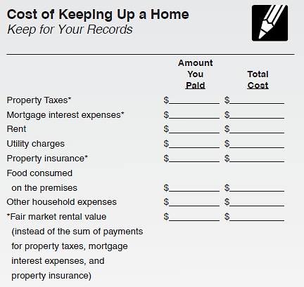
Providing a Home
Pub 4012 Tab B
Open Pub 4012
Tab B Cost of Keeping Up a Home
Note – Can use value of housing and apply
new rule
to open years
Notes:
Find the annotation in NTTC Modified Pub 4012

Slide 9
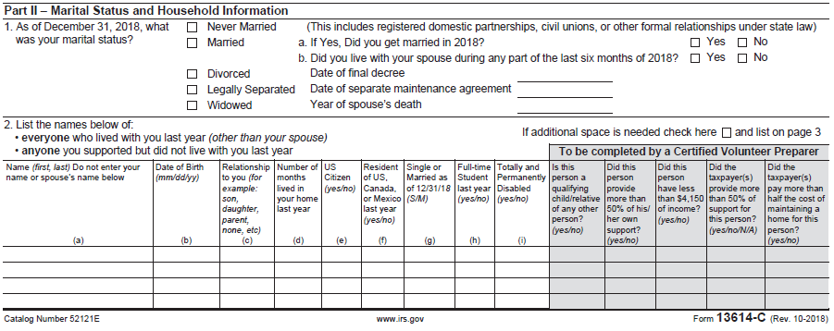
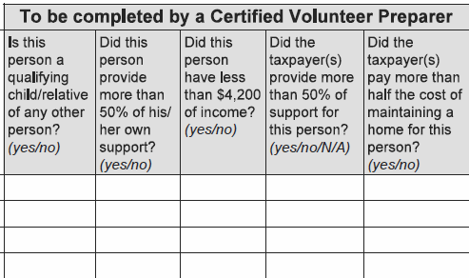
Intake Booklet
Check Part II entries in Intake Booklet
Ask questions – verify
Notes:
Note: The Taxpayer only tells us their marital status. The Counselor must determine the correct and most advantageous filing status based on a thorough interview with the taxpayer!

Slide 10
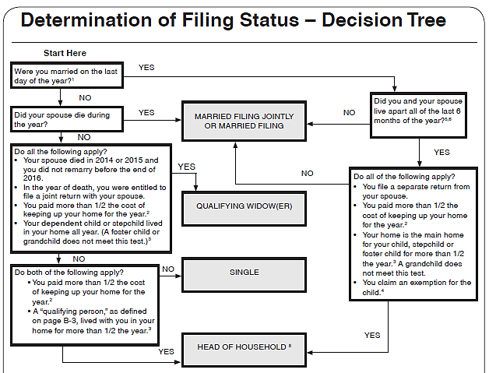
Use the Decision Tree
On the Tri-Fold
Resource Tool
Don’t miss the footnotes
Also see Interview Tips on Pub 4012 Tab B-7
Notes:
The Decision Tree is not included in Pub 4012. Volunteers will need to refer to the Tri-Fold Resource Tool
Direct Volunteers to open Pub 4012 to Page B-6 and lead a discussion using the Interview Tips
Head of Household Filing Status:
This filing status is generally for unmarried taxpayers who paid more than half the cost of keeping up a home for a qualified dependent relative during the tax year
If treated as unmarried for HoH purposes, it does not mean they are not married for other purposes
Married Filing Jointly:
Filing status for taxpayers who are married to each other or live together in a common law marriage and combine their income and deductions on the same tax return
The status also applies to taxpayers who are separated but not divorced and to taxpayers whose spouse died during the tax year and has not remarried, as long as one tax return is used for both individuals
Married Filing Separately:
Filing status for taxpayers who are married to each other and report their incomes and deductions on separate returns
Qualifying Widow(er) with Dependent Child:
Filing status is for widow or widower with one or more dependent children for two years following death of spouse
Single Filing Status:
Filing status that applies to a taxpayer who (1) has never married, or (2) is legally separated (Court Document!) or divorced, or (3) is widowed and is a not qualified widow(er)

Slide 11
IRS Link and Learn Job Aids
Interactive Tax Assistant to determine your filing status
irs.gov/FAQs - Filing Status
Publication 4491, Filing Status
These resources help verify Tri-Fold Resource Tool results
Notes:
For new volunteers this simple IRS YouTube Video might be an ice breaker or even a summary slide: Filing Status or https://www.youtube.com/watch?v=3vSLZLzszac

Slide 12
Filing Status – Tax Rate
Initial rates of tax – 2019
Status | Tax Rate is 10% on taxable income | Tax Rate is 12% on taxable income of
Single | Up to $ 9,700 | $ 9,701 – $39,475
Married Filing Jointly | Up to $19,400 | $19,401 – $78,950
Married Filing Separately | Up to $ 9,700 | $ 9,701 – $39,475
Head of Household | Up to $13,850 | $13,851 – $52,850
Qualifying widow(er) uses Married Filing Jointly tax rates

Slide 13
Single
Not married as of December 31st
Married but legally separated
There may be more advantageous filing status if:
Taxpayer has qualifying individuals
Taxpayer paid over half the cost of maintaining the home
Taxpayer is recently widowed (QW or HoH)
Notes:
Legally separated involves a court document; a private contract is not enough
Some taxpayers will mark “Legally Separated” on the I&I Sheet when they are simply not living together anymore. It is important to ask if they have a court document
As of 3/18, all states recognize “Legally Separate” EXCEPT Delaware, Florida, Georgia, Mississippi, Pennsylvania and Texas. Verify your state policy

Slide 14
Married Filing Jointly (MFJ)
Considered married on last day of year
Includes common law marriage if recognized by state
Spouse died during current tax year and taxpayer has not remarried
Generally, most advantageous filing status
Notes:
One return combining income and deductions of both spouses
On last day of year:
Married and live together
Live apart but not legally separated or divorced
Live together in recognized common law marriage
Separated but divorce decree not final
Spouse died during year/not remarried
Starting in 2018: Married taxpayers who didn’t live together at the end of 2018 and file MFJ are required to file when gross income is at least $5

Slide 15
Married Filing Separately (MFS)
Considered married on last day of year
Includes common law marriage if recognized by state
Each spouse files own tax return
Spouse’s Name and SSN must be entered on return
If SSN unknown
Enter SSN 111-00-1111
Return must be mailed
Notes:
Note some taxpayers believe they can file single when they have been separated for a long period of time and have no idea of the location of their spouse.
Starting in 2018: Married taxpayers filing MFS are required to file when gross income is at least $5

Slide 16
Married Filing Separately Disadvantages
Highest tax rate and lower standard deduction
85% of Social Security benefits taxable if lived with spouse at any time during year
Most tax credits disallowed
Cannot deduct student loan interest
Cannot use standard deduction if spouse itemized‏
Notes:
MFS – Lived With Spouse Anytime During The Year
Cannot claim credit for the elderly or the disabled, cannot claim education credits, EIC
Must include social security benefits as income (up to 85% can be taxable)‏, unless lived apart the whole year

Slide 17
Reason to File Married Filing Separately
Taxpayer chooses to file MFS
Spouse has already filed MFS or HoH
Married but separated and not filing MFJ
No liability for spouse’s tax obligation (see community property state exceptions)

Slide 18
Reason to File Married Filing Separately (cont.)
Lower combined tax
Lower repayment of Advance Premium Tax Credits (ACA)
Refund is not offset by spouse’s outstanding tax or other debts (see Injured Spouse in Comprehensive Topics as an alternative)
Nonresident alien spouse does not elect to be treated as a resident (see Unique Filing Status lesson)

Slide 19
Married Filing Separately in TaxSlayer
Extra TaxSlayer questions for MFS
Makes 85% of social security benefits taxable
Read requirements carefully – spouse has NO gross income
Spouse is NOT a dependent and does not qualify for new “credit for other dependents.”

Slide 20
Head of Household when Unmarried
Provided over half the cost of maintaining home for qualifying individuals
Dependents including dependent parents not living with taxpayer
Non-dependents that lived with taxpayer during the year
See special rules for divorced or separated parents Pub 4012
Tab C
Notes:
The trifold laminate can be helpful in determining head of household filing status.

Slide 21
Head of Household when Married
Taxpayers must
Have lived apart last 6 months of year
File separate returns
Have provided over half the cost of maintaining a home for
Dependent* child, stepchild, or eligible foster child for over six months
No other relatives qualify
* Special rules for divorced or separated parents: See Pub 4012 Tab C

Slide 22
Head of Household when Married
Key advantages to filing Head of Household
Higher standard deduction than Single or MFS
Advantageous tax rate structure
Ability to claim EIC when eligible
MFS excluded from EIC

Slide 23
Qualifying Widow(er)
Must have been entitled to file MFJ in year of death
Must have a dependent child* living in the home all year (grandchild does not qualify)
Paid over half the cost of keeping up the home for the dependent child
QW filing status eligible for two years following year of death
Advantages
Standard Deduction same as MFJ
MFJ tax rates
* See next slide
Notes:
Must have been eligible to use MFJ year of death but could have filed HoH or MFS
Use QW for two years following year of death (if eligible)
Year of death typically file MFJ

Slide 24
Qualifying Widow(er)
To qualify for QW filing status
Child must be a dependent or
Child would have been a dependent except
Gross income above the threshold amount
Filed MFJ
Taxpayer is a dependent (and therefore cannot have a dependent child)
Applies to all open tax years – can amend to receive refund

Slide 25
Special Notes
Pub 4012 Tab C
Child considered to have lived with taxpayer all year if born or died during year (but not stillborn)
Child may be considered a dependent of non-custodial parent under Rules for Divorced or Legally Separated Parents
Must have signed Form 8332 or similar document
Non-custodial parent tax benefits include child tax credit, credit for other dependent and education credits if eligible
Custodial parent retains right to HoH filing status and EIC when requirements are met
Notes:
Use Tri-fold to determine tax benefits for non-custodial parents with Form 8332

Slide 26
TaxSlayer – Filing Status
Refer to Pub 4012 – Entering Basic Information Section
Caution: Changing filing status during TaxSlayer return preparation deletes existing state returns
Notes:
Instructors should direct volunteers to open Pub 4012 and review the section on entering filing status in in the Entering Basic Information Section

Slide 27
Quality Review
Ask probing questions during Quality Review
More than just verifying a box is checked
Review prior year’s status
Verify current year filing status with data on Intake Sheet
Verify correct and most advantageous filing status has been entered

Slide 28
Filing Status - Quiz #1
Mr. Buck provides total support for his two young children
His wife died in 2016, and he has not remarried
What is the best filing status for Mr. Buck?
Head of Household
What if his wife died in TY2017?
Qualifying Widower

Slide 29
Filing Status - Quiz #2
Jane, 69, whose husband died July 1 of the current tax year, had a $20,000 pension and $15,000 in social security income during the year.
Jane’s 10-year-old grandson lived with her all year and is her dependent
Jane provided all the cost of maintaining the home for her grandson for the entire year.
What is Jane’s most advantageous filing status?
MFJ
Assuming nothing changes, what filing status should Jane use next year?
Head of Household
Notes:
Instructor follow-up: Why isn’t she eligible for Qualifying Widow?

Slide 30
Filing Status - Quiz #3
Luke and Linda are married, but chose to live apart for most of the year.
Their two children lived with Linda all year.
In July, Luke was out of a job and moved back in with Linda for three weeks.
What filing status can they each choose?
MFJ or MFS (both must use same status)
Notes:
Why can’t Linda claim HoH? Did not live apart last 6 months of the year.

Slide 31
Filing Status - Quiz #4
Peter is single
Peter’s mother lived with him until March of last year
Peter provided over half his mother’s support
Peter’s mother had gross income of $3,467
In March, Peter moved his mother to a nursing home and pays her room and care
What is Peter’s most advantageous filing status?
Head of Household
Notes:
Instructor follow-up: What if it was his older sister instead of his mother? Single. Unless a dependent parent, qualifying relative must have lived with taxpayer over 6 months. Peter could claim his sister as a dependent (if incapable of self-care which is probably why in a nursing home) and possible receive the $500 credit for other dependents.

Slide 32
Filing Status

Slide 33
Filing Status – Comprehensive Topics
Married Filing Separately in Community Property States
Injured Spouse
Notes:
If taxpayer is married to a non-resident alien, see Slide Deck #10 for filing status options

Slide 34
Community Property States – Community Income
Identifying and splitting community income may be necessary when
Filing MFS or HoH (if married and considered unmarried)
Divorced/separated during the year
Registered domestic partnerships (RDP) when state community property laws apply (CA, NV and WA)
Income splitting may be out of scope for community property states
Check with your District or State Coordinator
Notes:
Identifying and splitting community income are difficult legal issues – affected taxpayers should be referred to a paid preparer
Community property (income) laws vary by state
When the community exists at all during the year, income splitting is likely necessary

Slide 35
Married Filing Separately (or Single and RDP) in a Community Property State
MFS in community property state file Form 8958 (if in-scope per State Coordinator)
On Form 8958, enter $1 on spouse income line if
MFS couple did not live together at any time during the year
Have no joint income
Own no jointly held property
Notes:
The $1 can be on any line that has an amount however do not enter on withholding line. Will reduce refund by amount entered ($1).

Slide 36
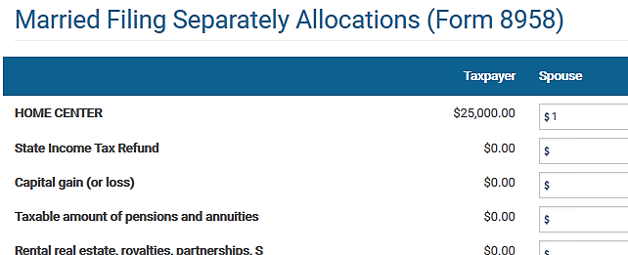
Married Filing Separately in a Community Property State
Notes:
The $1 can be on any line that has an amount however do not enter on withholding line. Will reduce refund by amount entered ($1).

Slide 37
Married Filing Separately in a Community Property State
Federal returns prepared with community property state entered as home state will trigger TaxSlayer E-file warning unless Form 8958 included on return
Notes:
MFS returns may be out of scope in a community property state due to the complexities of identifying and splitting community income
Community property states include: AZ, CA, ID, LA, NV, NM, TX, WA, and WI

Slide 38
Injured Spouse
IRS may offset (reduce) tax refund for spouse’s outstanding debt
Common IRS offsets
Past due child or spousal support
Federal nontax debts, e.g. student loans
Federal or state tax debts
State unemployment debts
An alternative to MFS is filing MFJ with Form 8379 Injured Spouse Allocation
Notes:
A common reason taxpayers choose MFS is to avoid an offset of their refund against their spouse’s outstanding debts

Slide 39
Injured Spouse Requirements
Only one spouse owes past due amounts
The MFJ return reflects an overpayment
The “Injured Spouse”
Must not be legally obligated to pay those debts
Must have made and reported tax payments (such as withholding) or claimed a refundable tax credit (i.e. due a refund)
Community property states may not honor Injured Spouse request even if debt was incurred prior to marriage
Notes:
In community property states, both spouses are liable for community debts

Slide 40
Form 8379 Injured Spouse Allocation
Form 8379 can be filed by itself when joint return has already been filed and refund was offset
Include copies of all forms for both spouses showing income tax withheld

Slide 41
IRS Form 8379 (partial view)

Slide 42
TaxSlayer Injured Spouse
Refer to Pub 4012 Tab O Navigating TaxSlayer for Injured Spouse
Proceed to the Injured Spouse Form 8379
Note warning the form does not guarantee outcome and can delay the refund up to 14 weeks

Slide 43
TaxSlayer Form 8379 Input
Review all tax documents to allocate the proper amount of income, deductions, additional taxes, taxes withheld, and credits to the injured spouse
Do not allocate EIC, the IRS will determine the allocation

Slide 44
Filing Status – Quiz #5
Jack and Jill Murphy are married and want to file MFS because Jack owes back child support and their refund will be offset.
What other options do they have?
They can file MFJ with Form 8379 Injured Spouse Allocation

Slide 45
Quiz #5 (Cont.)
What probing questions do you ask?
Is Jill legally obligated to pay any of the debts?
Did Jill make and report tax payments (such as withholding) or claim a refundable tax credit?
Notes:
Community property states may not comply with Injured Spouse requests

Slide 46
Head of Household – Married to Non-Resident Alien
See Slide Deck 10 Unique Filing Status

Slide 47
Filing Status

